Slide 1
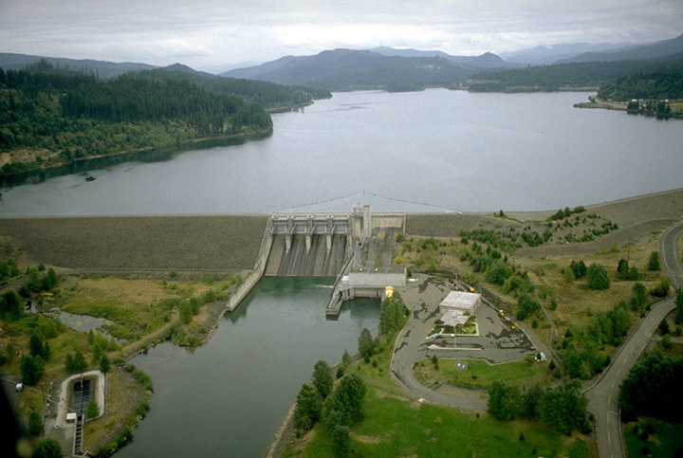
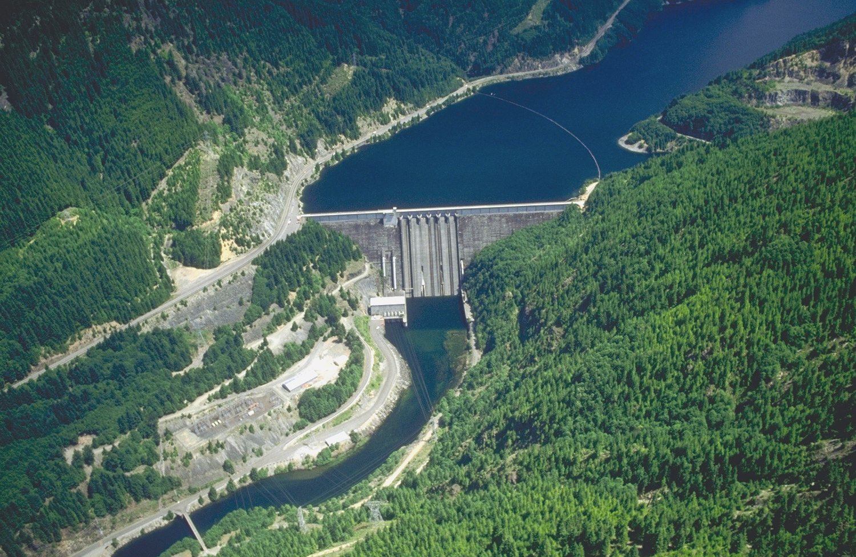
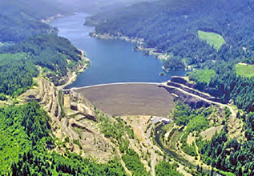
~Title: A comprehensive multi-year assessment of spring Chinook salmon (Oncorhynchus tshawytscha) throughout the Upper Willamette River, Oregon
Andrew Black, Nick Sard, Marc Johnson, Cameron Sharpe, Kathleen O’Malley
*Authorship order not determined

Slide 2
Of Note
This power point is just a template
Aim to accommodate everyone’s focus/priority
I have tried to provide structure
Review / synthesis
New data / analyses

Slide 3
Outline
Introduction
Materials and methods
Results
Discussion

Slide 4
Introduction
Threatened status of many salmon species
Dams / salmon migration & breeding
Management strategies
Different approaches used (HOR/NOR)
Critical issues identified to date
Important to step back and assess efficacy
Examined three dams in the upper Willamette River
North Santiam
South Santiam
South Fork McKenzie

Slide 5
Materials & Methods
Within sub-basins
Project background
Dam metrics (I couldn’t resist…)
Summary of genetic pedigree metrics / time
New genetic analyses
Between sub-basins
Differences in dam metrics
Comparison of genetic pedigree metrics /time / sub-basin
Comparison of new genetic analyses

Slide 6
Materials & Methods
Within sub-basins
Project background
Dam metrics
Summary of genetic pedigree metrics / time
New genetic analyses
Between sub-basins
Differences in dam metrics
Comparison of genetic pedigree metrics/time/sub-basin
Comparison of new genetic analyses

Slide 7
Materials & Methods:
Project background:
History
Overview of river
Release locations
Hatchery

Slide 8
Materials & Methods:
Dam metrics:
Reservoir stats
Water temperature
Gas issues
Redd counts?
Pre spawn mortality?
Census / sex ratio across time
pHOS
pNOS

Slide 9
Materials & Methods:
Genetic pedigree metrics:
CRR (male, female, total)
TLF (male, female, total)
Ne / Nc
Assignment rates

Slide 10
Materials & Methods:
New genetic analyses:
Subset of shared loci (~8)
Allelic Richness
Loss of alleles / time
Expected Heterozygosity / time

Slide 11
Materials & Methods
Within sub-basins
Project background
Dam metrics
Summary of genetic pedigree metrics / time
New genetic analyses
Between sub-basins
Differences in dam metrics
Comparison of genetic pedigree metrics /time /sub-basin
Comparison of new genetic analyses

Slide 12
Materials & Methods: BETWEEN Sub-Basin
Dam metrics:
Differences in reservoir stats
Differences in water temperature
Differences in gas issues
Differences in redd counts?
Differences in pre spawn mortality?
Differences in census / sex ratio across time
Obvious difference in pHOS?
Obvious difference in pNOS?

Slide 13
Materials & Methods: BETWEEN Sub-Basin
Genetic pedigree metrics:
CRR (male, female, total)
TLF (male, female, total)
Ne / Nc
Assignment rates

Slide 14
Materials & Methods: BETWEEN Sub-Basin
New genetic analyses:
Stray behavior
Genetic diversity pre/post incorporating strays?
Differences in genetic diversity between sub-basins?

Slide 15
Relevant Information sources/citations:
Genetic pedigree reports
Evans et al. 2015-CJFAS
Johnson and Friesen 2015-North American Journal of Fisheries Management
Johnson and Friesen 2013-North American Journal of Fisheries Management
Evans et al. 2015-Conservation Genetics
Romer and Monzyk 2014-North American Journal of Fisheries Management
Sard et al. 2015-CJFAS
Sard et al. 2016-Animal Conservation

Slide 16
What now?
1) Divide and conquer?
Individuals target specific sections of manuscript
Send results and / or rough paragraph(s) to Andrew
Andrew will incorporate / modify & send out for review / confirmation
Submit to journal
2) Consult / review future drafts

Slide 17
Materials & Methods
Within sub-basins
Project background
Dam metrics
Summary of genetic pedigree metrics / time
New genetic analyses
Between sub-basins
Differences in dam metrics
Comparison of genetic pedigree metrics / time /sub-basin
Comparison of new genetic analyses

Slide 18
Fluid timeline
Written summary / results: June 1st
First rough draft: July 1st
Target submission date: Sept. 30th

Slide 19
Target Journal?
Fish and Fisheries
Reviews is Fish Biology and Fisheries
Fisheries Management and Ecology
North American Journal of Fisheries Management

